Slide 1
Micro Credit Defaulter Project Presentation
Submitted By
VISHWAS PAI
Data Science Intern at Flip Robo Technologies

Slide 2
Introduction
Problem Statement:
A Microfinance Institution (MFI) is an organization that offers financial services to low income populations. MFS becomes very useful when targeting especially the unbanked poor families living in remote areas with not much sources of income. The Microfinance services (MFS) provided by MFI are Group Loans, Agricultural Loans, Individual Business Loans and so on. Many microfinance institutions (MFI), experts and donors are supporting the idea of using mobile financial services (MFS) which they feel are more convenient and efficient, and cost saving, than the traditional high-touch model used since long for the purpose of delivering microfinance services. Though, the MFI industry is primarily focusing on low income families and are very useful in such areas, the implementation of MFS has been uneven with both significant challenges and successes.

Slide 3
Introduction
Today, microfinance is widely accepted as a poverty-reduction tool, representing $70 billion in outstanding loans and a global outreach of 200 million clients. We are working with one such client that is in Telecom Industry. They are a fixed wireless telecommunications network provider. They have launched various products and have developed its business and organization based on the budget operator model, offering better products at Lower Prices to all value conscious customers through a strategy of disruptive innovation that focuses on the subscriber. They understand the importance of communication and how it affects a person’s life, thus, focusing on providing their services and products to low income families and poor customers that can help them in the need of hour. They are collaborating with an MFI to provide micro-credit on mobile balances to be paid back in 5 days. The Consumer is believed to be defaulter if he deviates from the path of paying back the loaned amount within the time duration of 5 days. For the loan amount of 5 (in Indonesian Rupiah), payback amount should be 6 (in Indonesian Rupiah), while, for the loan amount of 10 (in Indonesian Rupiah), the payback amount should be 12 (in Indonesian Rupiah).

Slide 4
Exercise
Build a model which can be used to predict in terms of a probability for each loan transaction, whether the customer will be paying back the loaned amount within 5 days of insurance of loan.
In this case, Label ‘1’ indicates that the loan has been paid i.e. Non- defaulter, while, Label ‘0’ indicates that the loan has not been paid i.e. defaulter.

Slide 5
Points to remember
There are no null values in the dataset.
There may be some customers with no loan history.
The dataset is imbalanced. Label ‘1’ has approximately 87.5 percent records, while, label ‘0’ has approximately 12.5 percent records.
For some features, there may be values which might not be realistic. You may have to observe them and treat them with a suitable explanation.
You might come across outliers in some features which you need to handle as per your understanding. Keep in mind that data is expensive and we cannot lose more than 7-8 percent of the total data.

Slide 6
Project Goals
Analytical Problem Framing
Exploratory Data Analysis (EDA)
Visualizations
Data Pre-Processing on train and test datasets
Model/s Development and Evaluation
Performing hyper parameter tuning, saving the best model and predicting the label
Conclusion and future work discussion

Slide 7
Technology
Hardware technology being used.
RAM : 8.00 GB
CPU : Intel(R) Core(TM) i5-10300H CPU @ 2.50GHz
GPU : NVIDIA GeForce GTX 1650 Ti
Software technology being used.
Programming language : Python
Distribution : Anaconda Navigator
Browser based language shell : Jupyter Notebook
Libraries/Packages specifically being used.
Pandas , NumPy, matplotlib, seaborn, scikit-learn, pandas-profiling, missingno

Slide 8
Data Description
label : Flag indicating whether the user paid back the credit amount within 5 days of issuing the loan {1:success, 0:failure}
msisdn : Mobile number of user
aon : Age on cellular network in days
daily_decr30 : Daily amount spent from main account, averaged over last 30 days (in Indonesian Rupiah)
daily_decr90 : Daily amount spent from main account, averaged over last 90 days (in Indonesian Rupiah)
rental30 : Average main account balance over last 30 days
rental90 : Average main account balance over last 90 days
last_rech_date_ma : Number of days till last recharge of main account
last_rech_date_da : Number of days till last recharge of data account
last_rech_amt_ma : Amount of last recharge of main account (in Indonesian Rupiah)
cnt_ma_rech30 : Number of times main account got recharged in last 30 days
fr_ma_rech30 : Frequency of main account recharged in last 30 days

Slide 9
Data Description
sumamnt_ma_rech30 : Total amount of recharge in main account over last 30 days (in Indonesian Rupiah)
medianamnt_ma_rech30 : Median of amount of recharges done in main account over last 30 days at user level (in Indonesian Rupiah)
medianmarechprebal30 : Median of main account balance just before recharge in last 30 days at user level (in Indonesian Rupiah)
cnt_ma_rech90 : Number of times main account got recharged in last 90 days
fr_ma_rech90 : Frequency of main account recharged in last 90 days
sumamnt_ma_rech90 : Total amount of recharge in main account over last 90 days (in Indonesian Rupiah)
medianamnt_ma_rech90 : Median of amount of recharges done in main account over last 90 days at user level (in Indonesian Rupiah)
medianmarechprebal90 : Median of main account balance just before recharge in last 90 days at user level (in Indonesian Rupiah)
cnt_da_rech30 : Number of times data account got recharged in last 30 days
fr_da_rech30 : Frequency of data account recharged in last 30 days
cnt_da_rech90 : Number of times data account got recharged in last 90 days

Slide 10
Data Description
fr_da_rech90 : Frequency of data account recharged in last 90 days
cnt_loans30 : Number of loans taken by user in last 30 days
amnt_loans30 : Total amount of loans taken by user in last 30 days
maxamnt_loans30 : Maximum amount of loan taken by the user in last 30 days
medianamnt_loans30: Median of amounts of loan taken by the user in last 30 days
cnt_loans90 : Number of loans taken by user in last 90 days
amnt_loans90 : Total amount of loans taken by user in last 90 days
maxamnt_loans90 : Maximum amount of loan taken by the user in last 90 days
medianamnt_loans90: Median of amounts of loan taken by the user in last 90 days
payback30 : Average payback time in days over last 30 days
payback90 : Average payback time in days over last 90 days
pcircle : Telecom circle
pdate : Date

Slide 11
Exploratory Data Analysis
Shape : 2,09,593 rows and 37 columns
No null values present
Only one duplicate row/record found
Datatypes of float, integer and object are in dataset
First I have imported the necessary libraries and loaded the entire dataset in our Jupyter Notebook and renamed the project file.
Then I checked the shape of our dataset and found that we have a total of 2,09,593 rows and 37 different columns.
We don’t have any null values or missing values present in our dataset.
There was only one duplicate row/record in our dataset and I removed it from our dataset.
By checking the data types I came to know that our data set consists of columns have float, integer and object data type values.

Slide 12
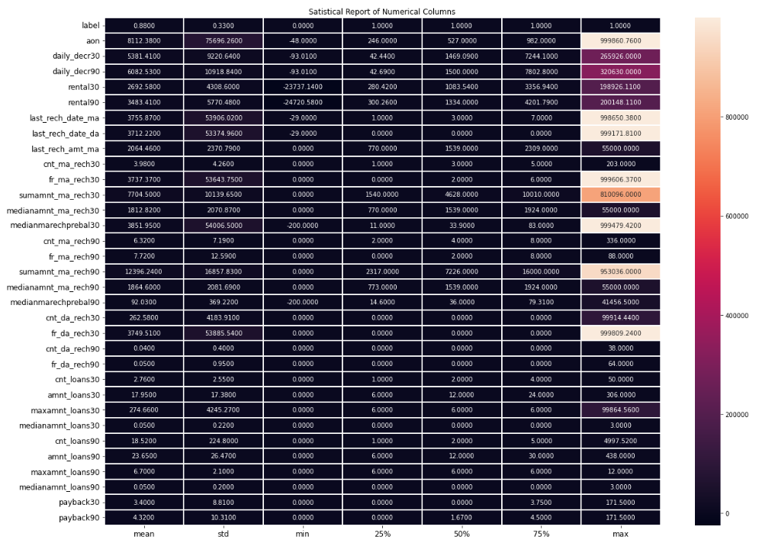
Describe
Here we see a statistical representation of the all the numeric data columns.

Slide 13
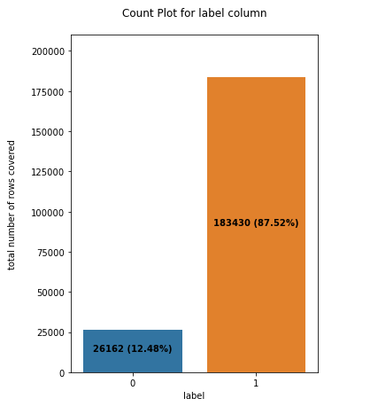
Univariate Analysis
With the help of count plots I was able to get the total number of rows covered by each unique categorical value present in all the columns of our dataset. I ensured that along with the total row number the percentage of data coverage is made visible too.

Slide 14
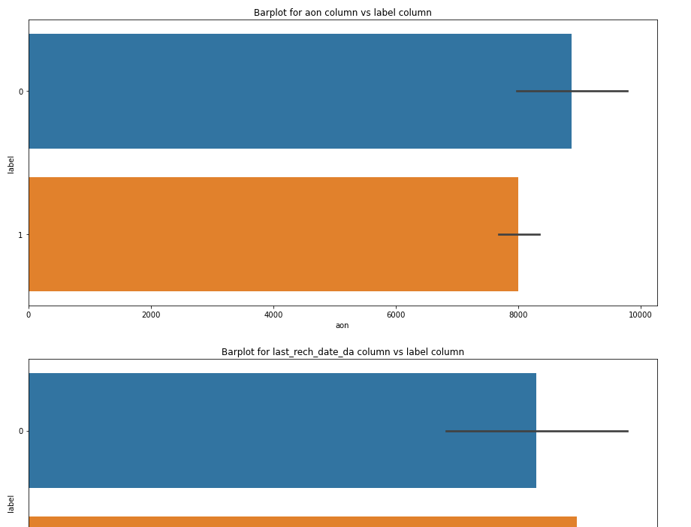
Bivariate Analysis
With the help of Bar Plot we are able to see the success and failure label data for the columns basically the feature data.

Slide 15
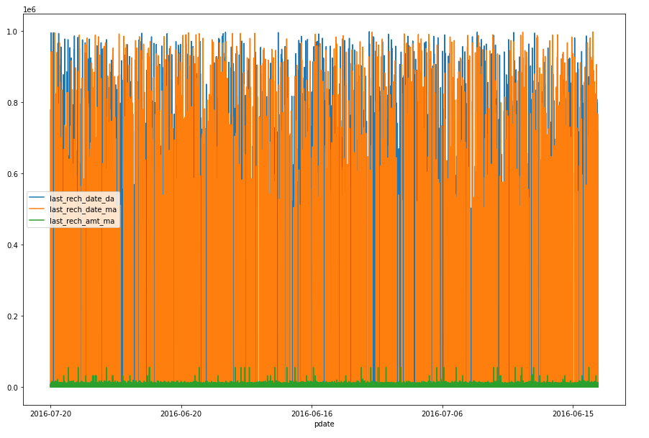
Bivariate Analysis
Using the line plots I checked the object data type for date and mobile number data present in our dataset.

Slide 16
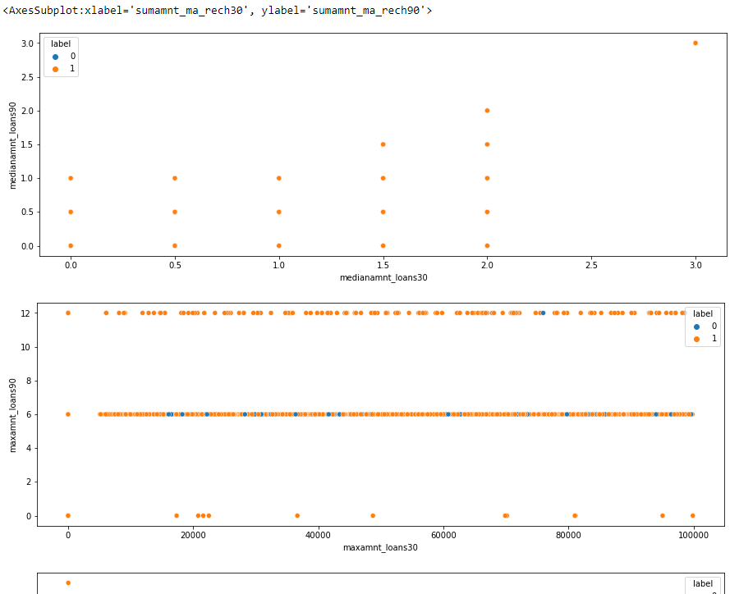
Bivariate Analysis
Using the scatter plot we checked the success and failure label data points and their variations plus distributions to confirm further analysis and outlier data.

Slide 17
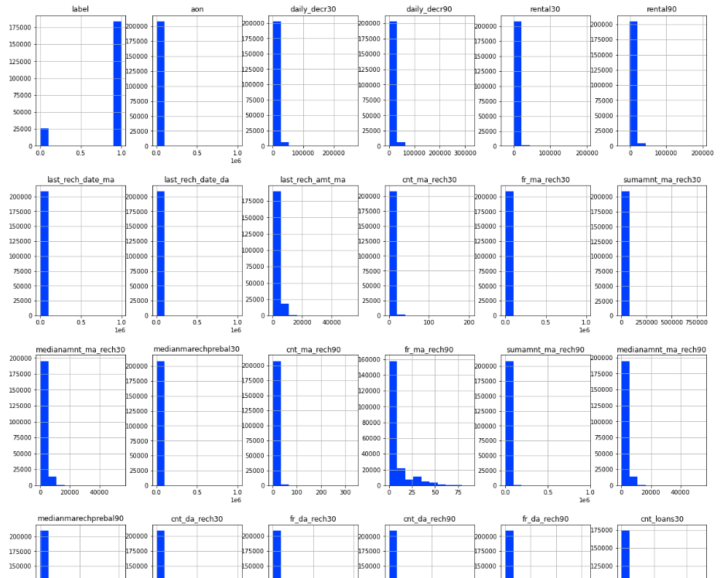
Multivariate Analysis
I used the histogram to check through all the column details ensuring that the distribution is displayed for further analysis

Slide 18
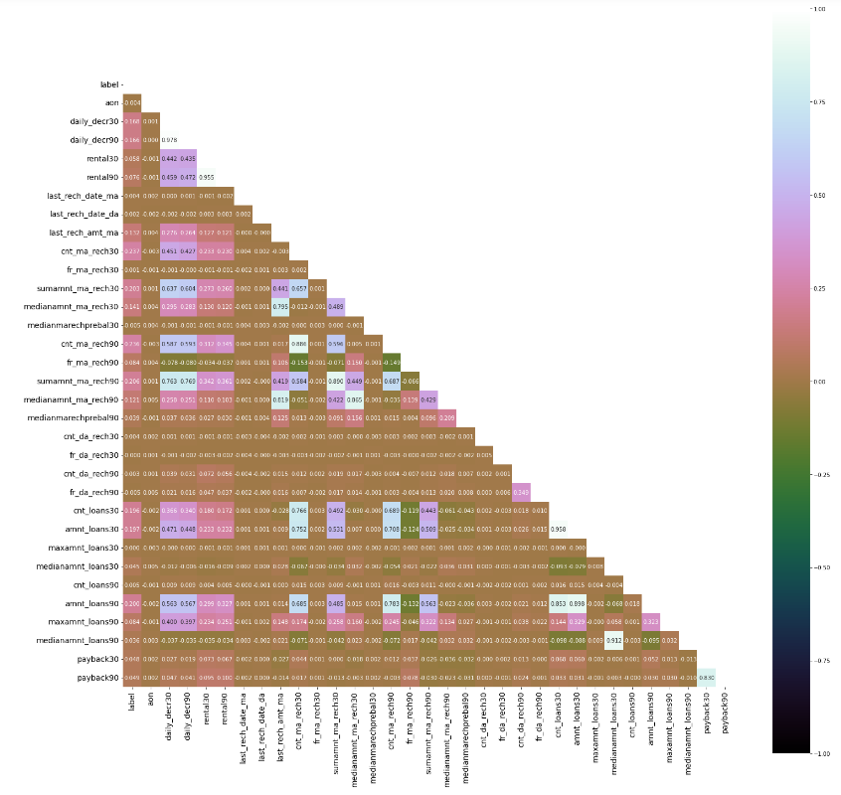
Multivariate Analysis
Used the heatmap to check the correlation specifically between the label and feature data columns
Also we checked for any multi collinearity concerns between feature column data

Slide 19
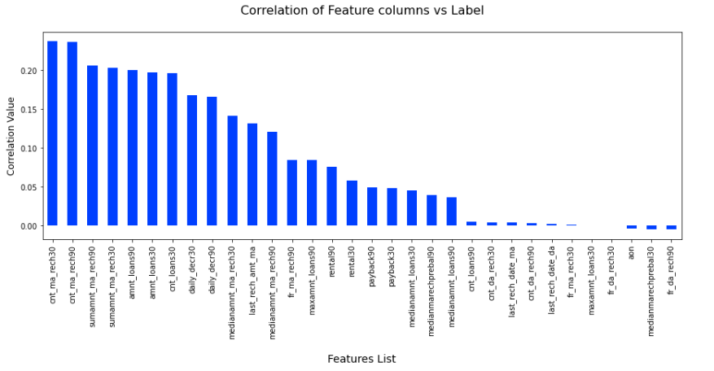
Correlation Bar
Using a Bar Plot we checked the correlation between the label column and feature columns to determine the one’s that are positively and negatively correlated

Slide 20
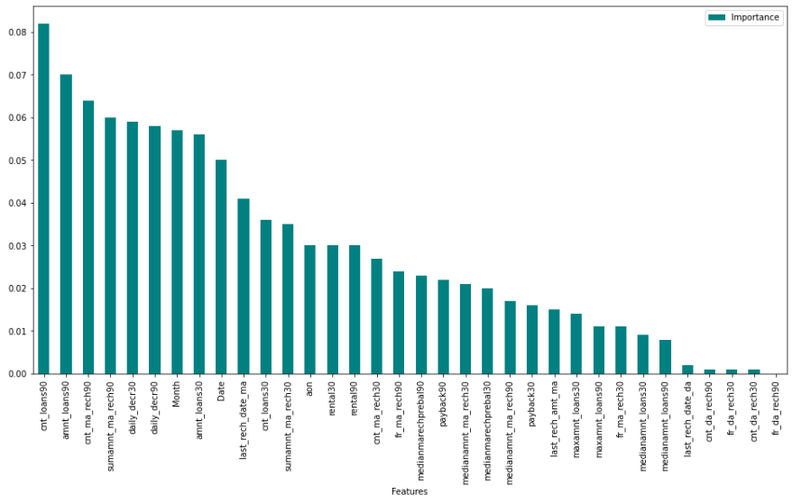
Importance Bar
Using the Random Forest Classifier we were able to get the importance data and dropped the least contributing feature columns.

Slide 21
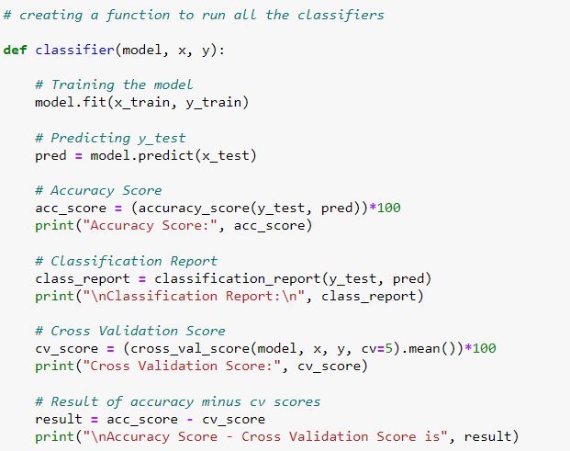
Classification Function
I created this classification function to obtain the various input model details along with metric information on accuracy, cross validation, the classification report and the difference between accuracy and cross validation using 5 folds to avoid overfitting and underfitting concerns.

Slide 22
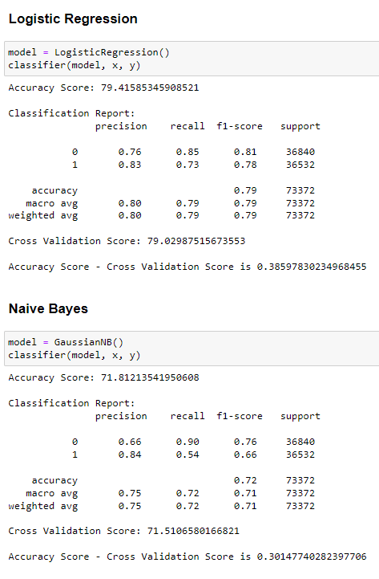
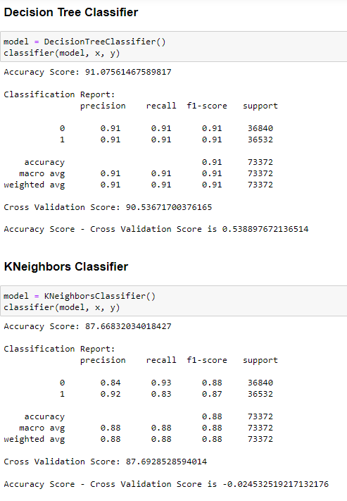
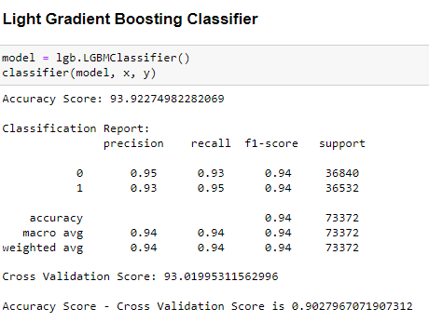
Classification Machine Learning Models Used
I made use of 11 Classification Machine Learning Models to check through the best accuracy along with cross validation score.

Slide 23
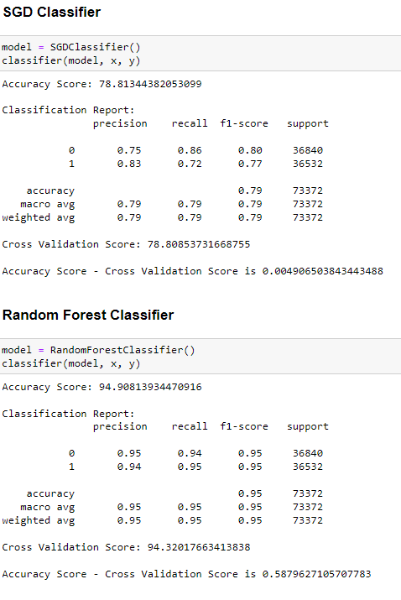
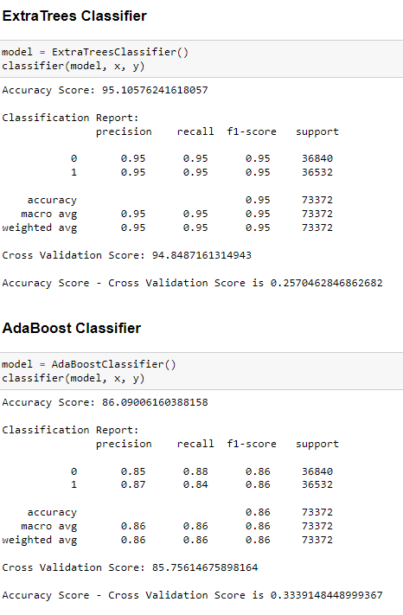
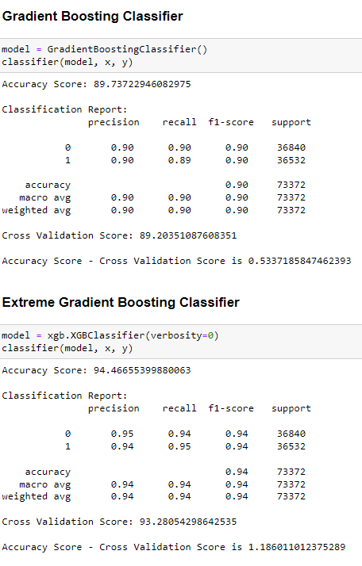

Slide 24
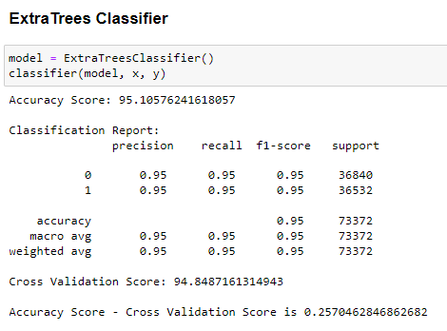
Report on Best Model
I chose Extra Trees Classifier as my best model and then proceed to perform hyper parameter tuning on the same

Slide 25
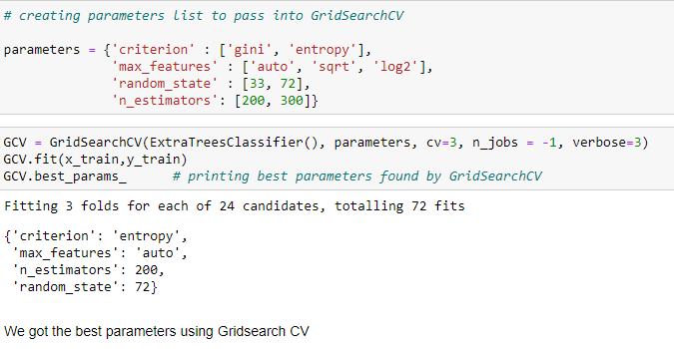
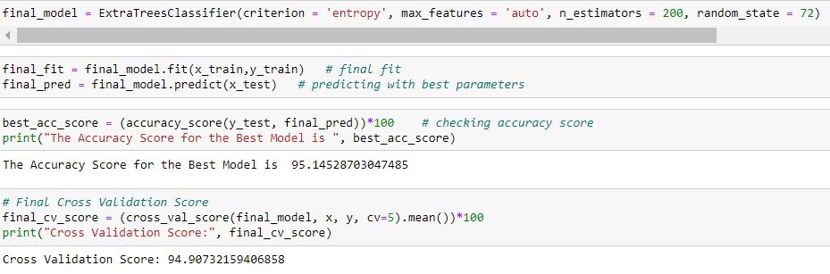
Hyper parameter tuning

Slide 26
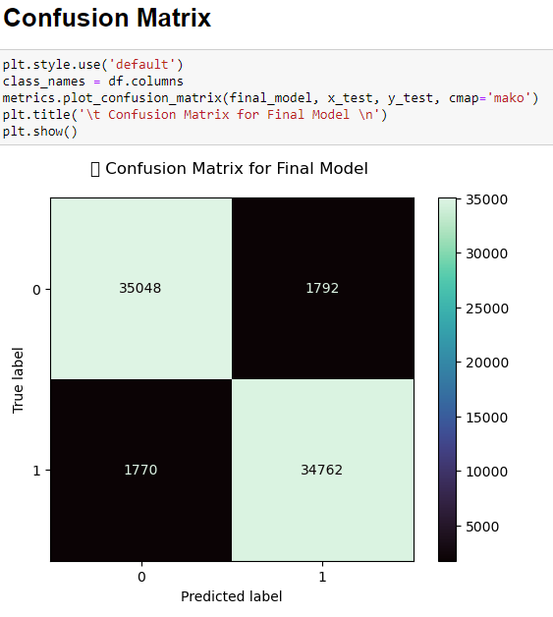
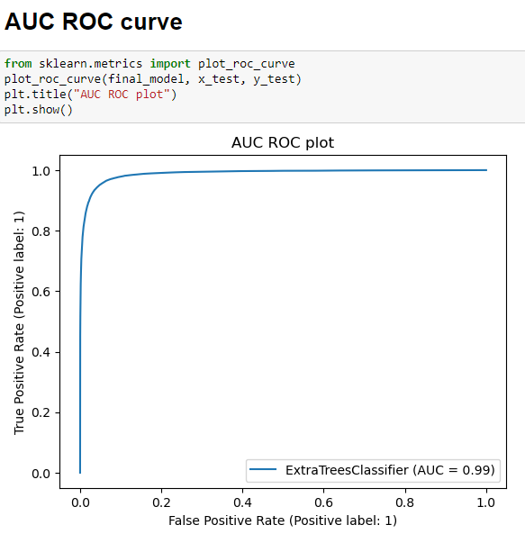
Hyper parameter tuning result

Slide 27
Conclusion
Key Findings and Conclusions of the Study: From the final model MFI can find if a person will return money or not and should a MFI provide a load to that person or not judging from the various features taken into consideration.
Learning Outcomes of the Study in respect of Data Science: I built multiple classification models and did not rely on one single model for getting better accuracy and using cross validation comparison I ensured that the model does not fall into overfitting and underfitting issues. I picked the best one and performed hyper parameter tuning on it to enhance the scores.

Slide 28
Limitations of this work and Scope for Future Work
Limitation is it will only work for this particular use case and will need to be modified if tried to be utilized on a different scenario but on a similar scale.
Scope is that we can use it in companies to find whether we should provide loan to a person or not and we can also make prediction about a person buying an expensive service on the basis of there personal details that we have in this dataset like number of times data account got recharged in last 30 days and daily amount spent from main account, averaged over last 30 days (in Indonesian Rupiah) so even a marketing company can also use this.

Slide 29
THANK YOU

